Slide 1

ATTRIBUTION QUERIES
Learn SQL from Scratch
SUCHITA KAUNDIN
10/08/2018

Slide 2
Table of Contents
Get familiar with CoolTShirts
What is the user journey?
Optimize the campaign budget

Slide 3
1.1 Get familiar with CoolTShirts
How many campaigns and sources does CoolTShirts use? Which source is used for each campaign?
Use three queries:
one for the number of distinct campaigns,

Slide 4
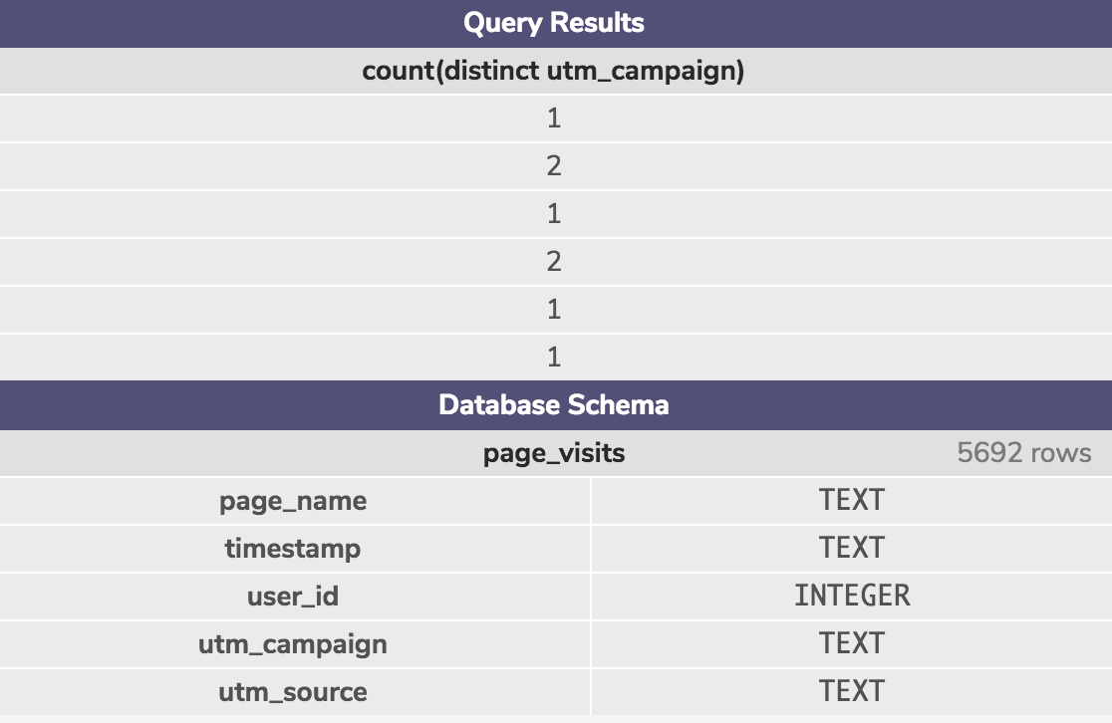
1.1 Get familiar with CoolTShirts
-- You can put your query here
-- 1. Number of distinct campaigns
SELECT COUNT(DISTINCT UTM_CAMPAIGN) FROM PAGE_VISITS GROUP BY UTM_SOURCE ;

Slide 5
1.1 Get familiar with CoolTShirts
1.How many campaigns and sources does CoolTShirts use? Which source is used for each campaign?
Use three queries:
one for the number of distinct sources.
-- You can put your query here
-- 2. Number of distinct sources
SELECT COUNT(DISTINCT UTM_SOURCE) FROM PAGE_VISITS GROUP BY UTM_CAMPAIGN;

Slide 6
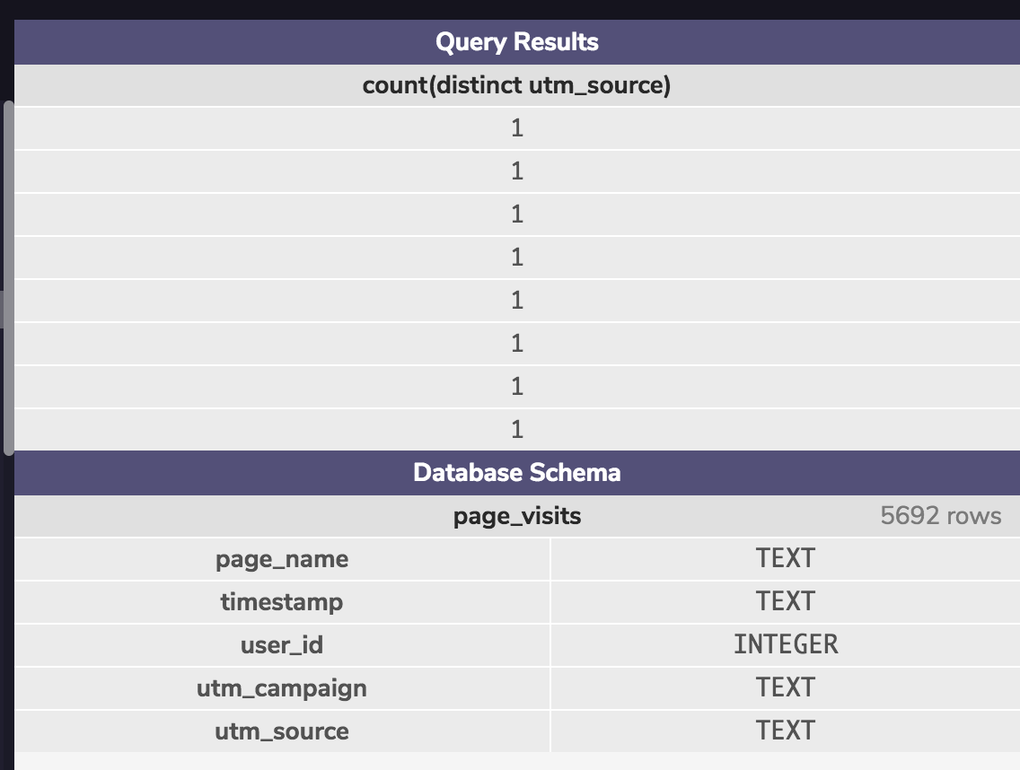
1.1 Get familiar with CoolTShirts
-- You can put your query here
-- 2. Number of distinct sources
SELECT COUNT(DISTINCT UTM_SOURCE) FROM PAGE_VISITS GROUP BY UTM_CAMPAIGN;

Slide 7
1.1 Get familiar with CoolTShirts
How many campaigns and sources does CoolTShirts use? Which source is used for each campaign?
Use three queries:
one to find how they are related.
-- You can put your query here
-- 3. one to find how they are related.
SELECT DISTINCT utm_source, utm_campaign from page_visits;

Slide 8
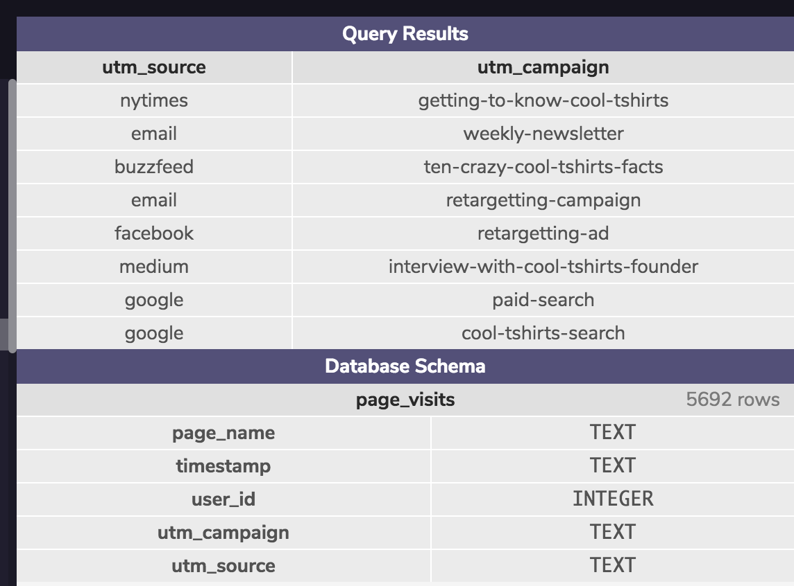
1.1 Get familiar with CoolTShirts
-- You can put your query here
-- 3. one to find how they are related.
SELECT DISTINCT utm_source, utm_campaign from page_visits;

Slide 9
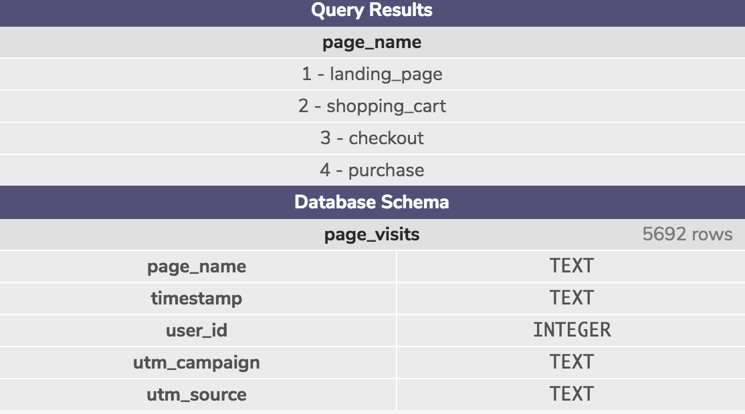
1.2.What pages are on the CoolTShirts website?
-- You can put your query here
-- Find distinct value of the page_name column.
SELECT DISTINCT PAGE_NAME FROM PAGE_VISITS;
Find the distinct values of the page_name column.

Slide 10
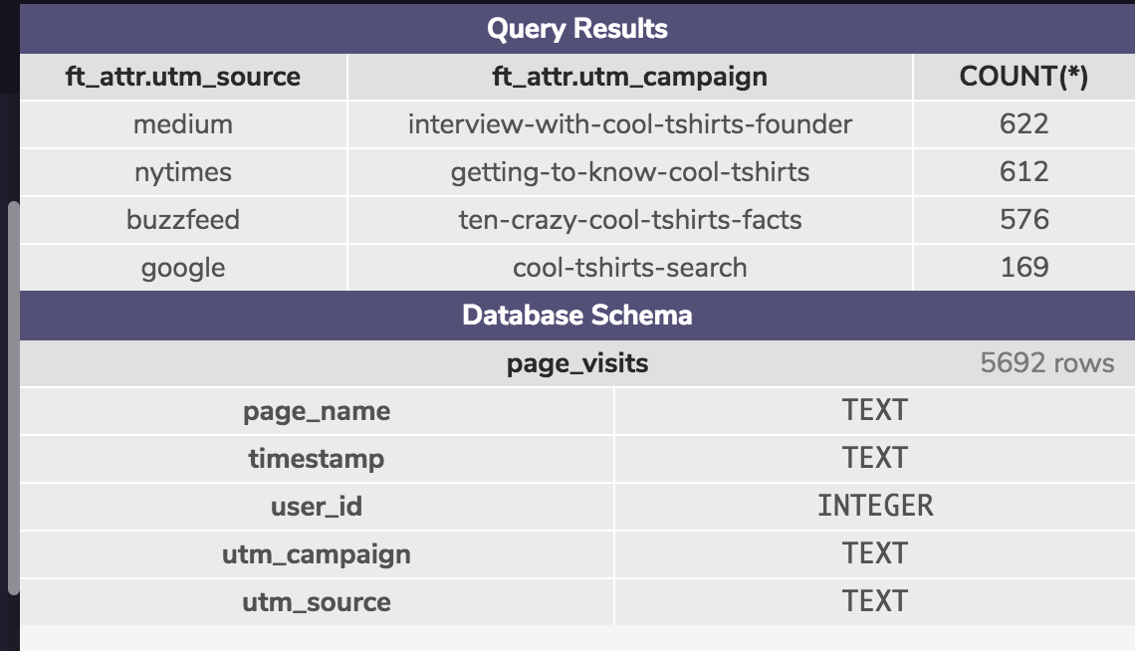
2. What is the user journey?
How many first touches is each campaign responsible for?
You'll need to use the first-touch query from the lesson(also provided in the hint below). Group by campaign and count the number of first touches for each.
-- You can put your query here
WITH first_touch AS (
SELECT user_id,
MIN(timestamp) as first_touch_at
FROM page_visits
GROUP BY user_id),
ft_attr AS (
SELECT ft.user_id,
ft.first_touch_at,
pv.utm_source,
pv.utm_campaign
FROM first_touch ft
JOIN page_visits pv
ON ft.user_id = pv.user_id
AND ft.first_touch_at = pv.timestamp
)
select ft_attr.utm_source,
ft_attr.utm_campaign, COUNT(*)
from ft_attr GROUP BY 1, 2
ORDER BY 3 DESC;

Slide 11
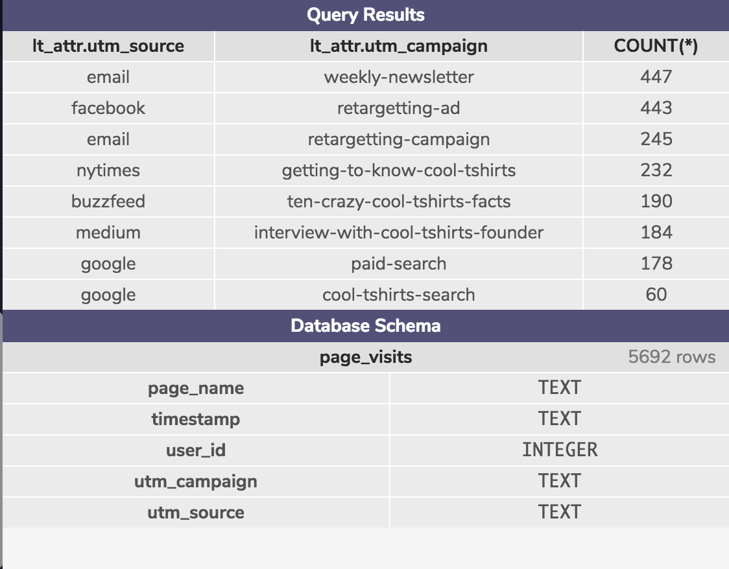
3.How many last touches is each campaign responsible for?
How many last touches is each campaign responsible for?
Starting with the last-touch query from the lesson, group by campaign and count the number of last touches for each.
-- You can put your query here
WITH last_touch AS (
SELECT user_id,
MAX(timestamp) as last_touch_at
FROM page_visits
GROUP BY user_id),
lt_attr AS (
SELECT lt.user_id,
lt.last_touch_at,
pv.utm_source,
pv.utm_campaign,
pv.page_name
FROM last_touch lt
JOIN page_visits pv
ON lt.user_id = pv.user_id
AND lt.last_touch_at = pv.timestamp
)
SELECT lt_attr.utm_source,
lt_attr.utm_campaign,
COUNT(*)
FROM lt_attr
GROUP BY 1, 2
ORDER BY 3 DESC;

Slide 12
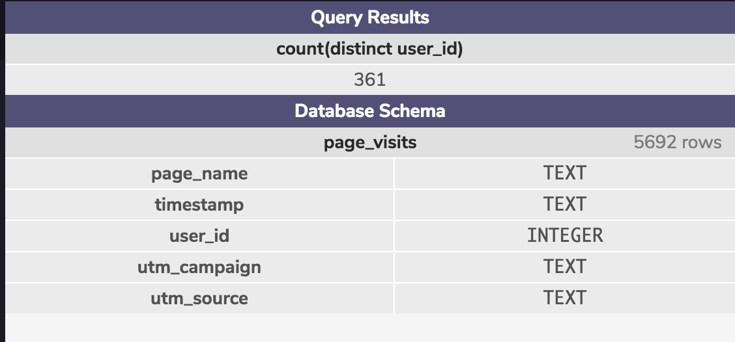
Count the distinct users who visited the page named 4 - purchase.
-- You can put your query here
SELECT COUNT(DISTINCT USER_ID) FROM PAGE_VISITS WHERE PAGE_NAME = '4 - PURCHASE' GROUP BY PAGE_NAME;

Slide 13
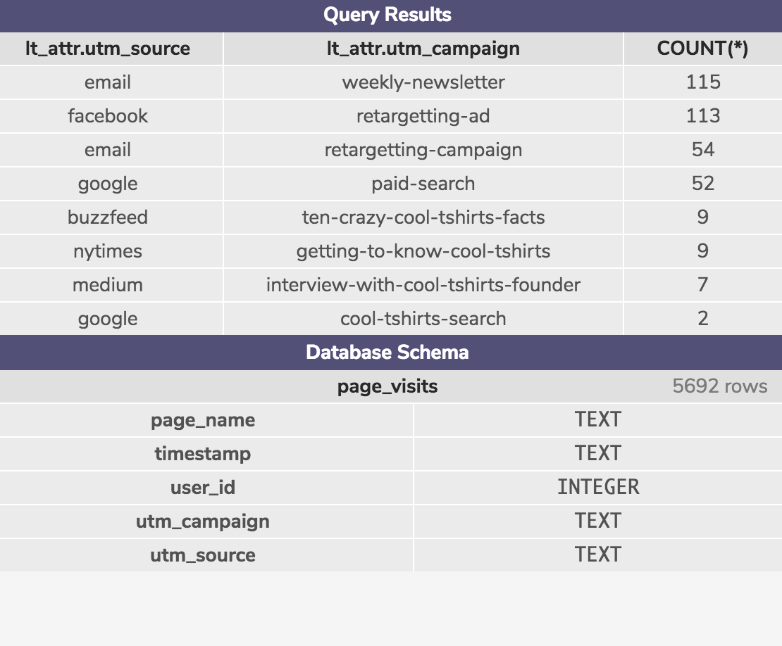
How many last touches on the purchase page is each campaign responsible for?
This query will look similar to your last-touch query, but with an additional WHERE clause.
-- You can put your query here
WITH last_touch AS (
SELECT user_id,
MAX(timestamp) as last_touch_at
FROM page_visits
WHERE page_name = '4 - purchase'
GROUP BY user_id),
lt_attr AS (
SELECT lt.user_id,
lt.last_touch_at,
pv.utm_source,
pv.utm_campaign,
pv.page_name
FROM last_touch lt
JOIN page_visits pv
ON lt.user_id = pv.user_id
AND lt.last_touch_at = pv.timestamp
)
SELECT lt_attr.utm_source,
lt_attr.utm_campaign,
COUNT(*)
FROM lt_attr
GROUP BY 1, 2
ORDER BY 3 DESC;

Slide 14
SQL QUERY :
https://gist.github.com/e40af162f324c27192a7838bb7988cbe

